Slide 1
Modernización CICS Creación y uso de APIs para una integración eficiente
Diego Rodríguez Bravo Technical Consultant
diego.rodriguez@broadcom.com

Slide 2
MTE Session Presentation & Naming Rules
Ensure that the 2025 copyright is at the bottom of each slide, including slides you paste into this deck.
If you have questions about pasting slides from an existing presentation, please watch this short video.
Review this Screenshot and Demo Best Practices presentation if you are including any screenshots or showing demos.
Session names must match the approved MTE event session name.
Save with this file name standard = “Session ID - Session Title”
The 2025 Disclaimer slide (slide 3) should be the 1st slide in your presentation, following the title slide. Please do not edit this slide, AND it is NOT necessary to talk about this slide as it is in every presentation.
Slides 4-6 are the core MTE Template slides. Don’t forget to delete any template slides that you don’t need from your presentation.
Slides 7-14 are optional/alternative designs you may use. Don’t forget to delete any of these that you do not use.
Slide 15 is a Next Steps Slide – please do NOT delete this slide, and update it with relevant links and resources
Slide 16 is a Session Survey Slide – please do not delete this and be sure it is right before your Thank You Slide.
Slides 17 is the Thank You slide. It should be the final slide in your presentation.
Complete a spellcheck.
When possible, consider including demos in your presentations.
Use case and benefit examples are required to be in all presentations, per MSD Leadership. See examples here.

Slide 3
Disclaimer
Certain information in this presentation may outline Broadcom’s general product direction. This presentation shall not serve to (i) affect the rights and/or obligations of Broadcom or its licensees under any existing or future license agreement or services agreement relating to any Broadcom software product; or (ii) amend any product documentation or specifications for any Broadcom software product. This presentation is based on current information and resource allocations as of March 25, 2025, and is subject to change or withdrawal by Broadcom at any time without notice. The development, release and timing of any features or functionality described in this presentation remain at Broadcom’s sole discretion.
Notwithstanding anything in this presentation to the contrary, upon the general availability of any future Broadcom product release referenced in this presentation, Broadcom may make such release available to new licensees in the form of a regularly scheduled major product release. Such release may be made available to licensees of the product who are active subscribers to Broadcom maintenance and support, on a when and if-available basis. The information in this presentation is not deemed to be incorporated into any contract.
Broadcom may use any feedback provided by you related to a Broadcom product or this presentation for any Broadcom business purposes (including but not limited to, preparation, reproduction, and distribution of derivative works based upon such feedback), without any obligation to you including consent or payment.
Copyright © 2025 Broadcom. All rights reserved. The term “Broadcom” refers to Broadcom Inc. and/or it’s subsidiaries. Broadcom, the pulse logo, Connecting everything, CA Technologies and the CA Technologies logo are among the trademarks of Broadcom.
THIS PRESENTATION IS FOR YOUR INFORMATIONAL PURPOSES ONLY. Broadcom assumes no responsibility for the accuracy or completeness of the information. TO THE EXTENT PERMITTED BY APPLICABLE LAW, BROADCOM PROVIDES THIS DOCUMENT “AS IS” WITHOUT WARRANTY OF ANY KIND, INCLUDING, WITHOUT LIMITATION, ANY IMPLIED WARRANTIES OF MERCHANTABILITY, FITNESS FOR A PARTICULAR PURPOSE, OR NONINFRINGEMENT. In no event will Broadcom be liable for any loss or damage, direct or indirect, in connection with this presentation, including, without limitation, lost profits, lost investment, business interruption, goodwill, or lost data, even if Broadcom is expressly advised in advance of the possibility of such damages.

Slide 4
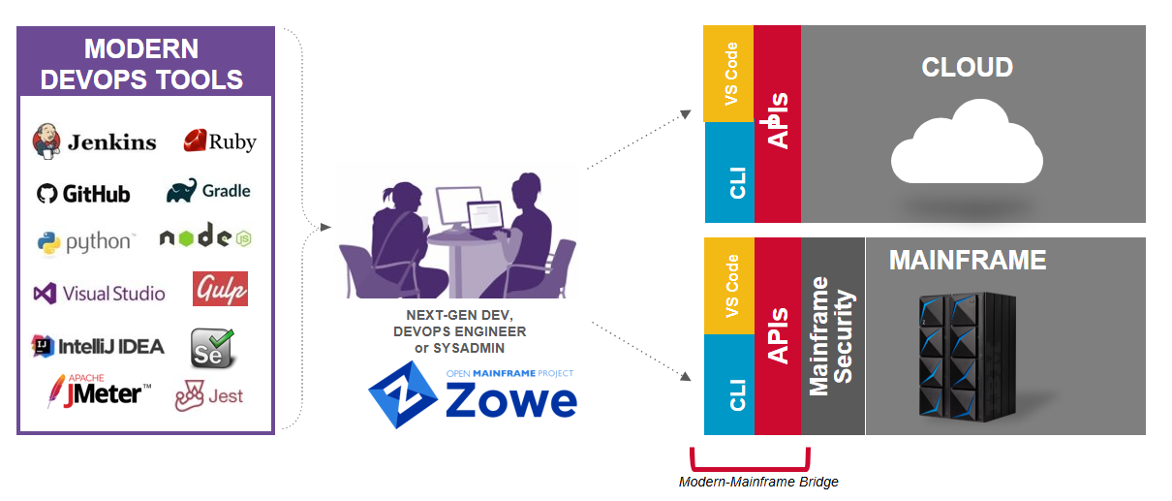
The Open Mainframe Advantage
Notes:
El mainframe es la tecnología más moderna y duradera. Su fiabilidad, escalabilidad y adaptación la hace ser la plataforma por excelencia.
El mainframe ha estado en un silo durante muchos años

Slide 5
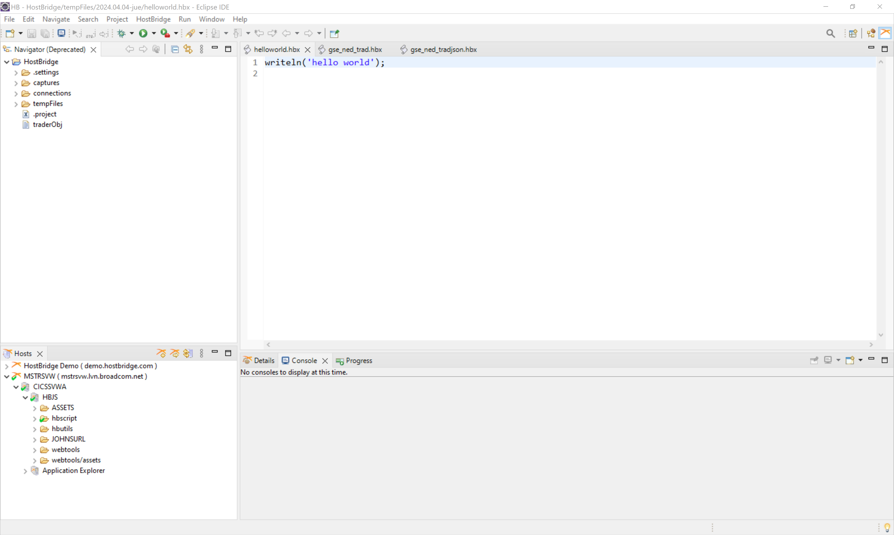
ECLIPSE IDE

Slide 6

VSCode
Zowe Explorer

Slide 7
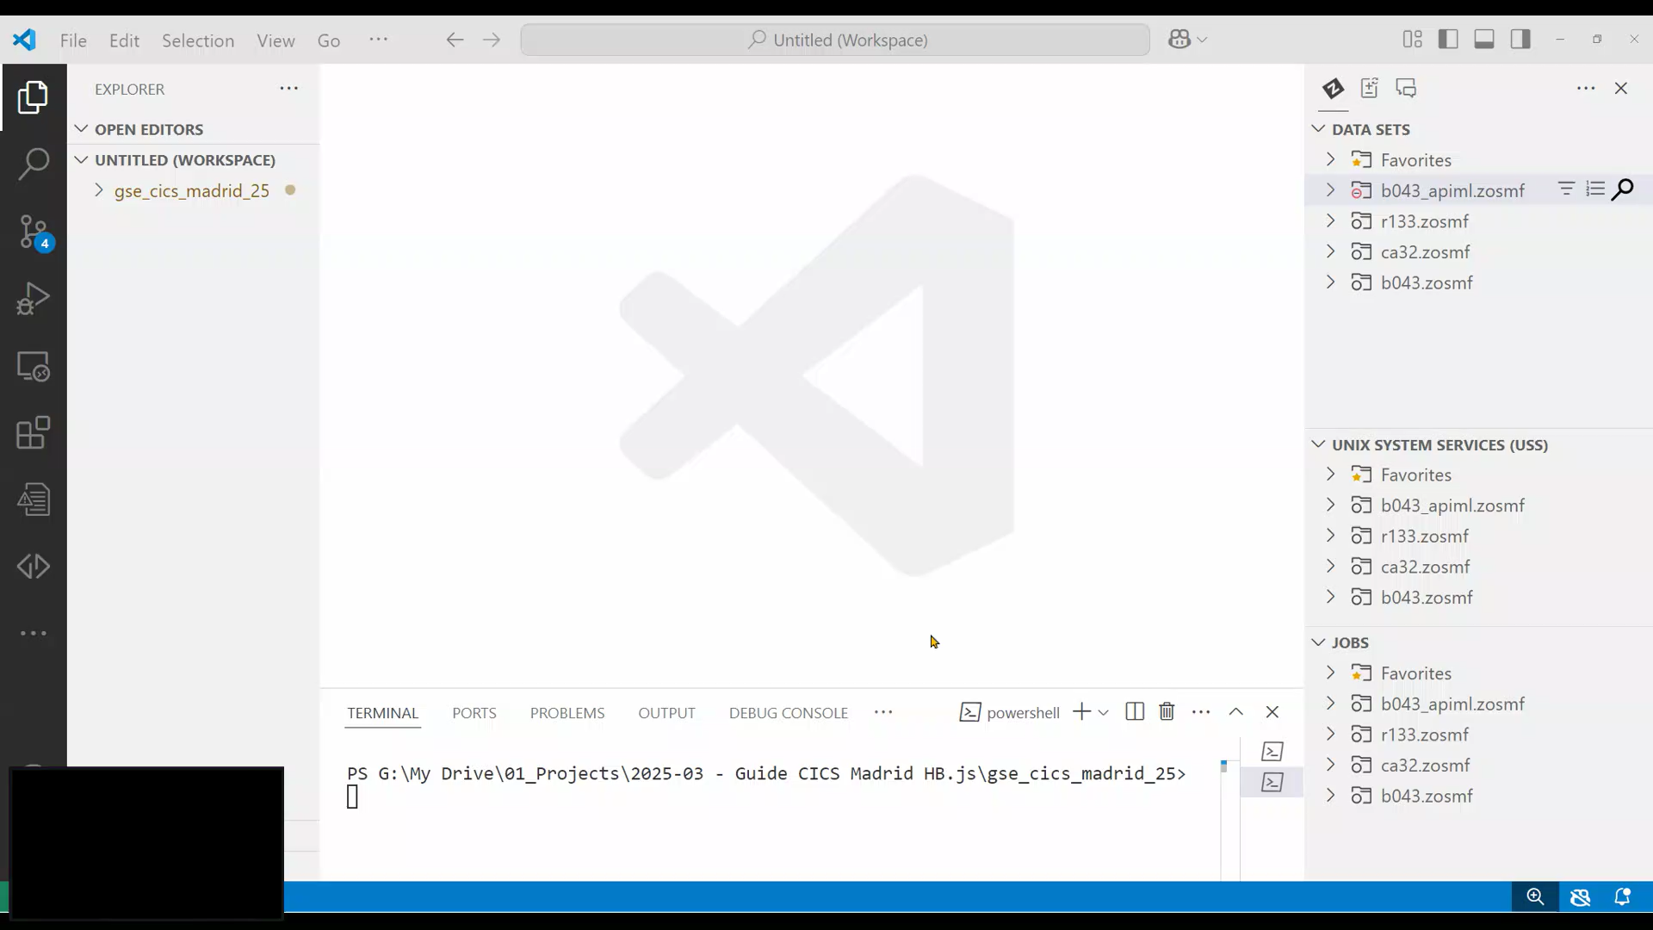

Slide 8
TRAD
IBM Demo Transaction

Slide 9
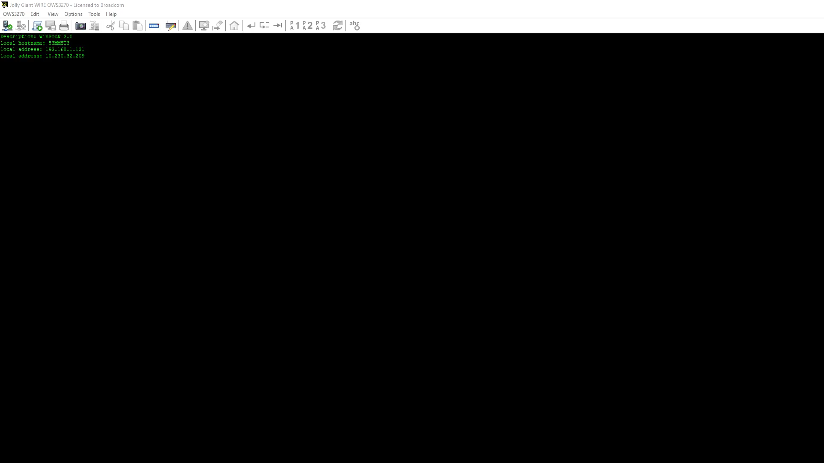

Slide 13




Slide 14


Slide 15
Insert Headline

Slide 16

Insert Headline

Slide 17

Insert Headline
17
Copyright © 2025 Broadcom. All Rights Reserved. The term "Broadcom" refers to Broadcom, Inc. and/or its subsidiaries.

Slide 18

18
Copyright © 2025 Broadcom. All Rights Reserved. The term "Broadcom" refers to Broadcom, Inc. and/or its subsidiaries.

Slide 19

Insert Headline
19
Copyright © 2025 Broadcom. All Rights Reserved. The term "Broadcom" refers to Broadcom, Inc. and/or its subsidiaries.

Slide 20

20
Copyright © 2025 Broadcom. All Rights Reserved. The term "Broadcom" refers to Broadcom, Inc. and/or its subsidiaries.

Slide 21
Next Steps
<Insert links to relevant documentation>
<Insert links to Learning Path or relevant Education courses>
<Insert link to relevant Mainframe Community>
<Insert Speaker contact information>

Slide 22

Share Your Feedback
Please complete the Session Survey in the attendee portal to help us improve future sessions.
Scan Here:
Or Click Here:
https://reg.rainfocus.com/flow/broadcom/euromte25/attendeeportal/
Notes:
Attendees will be asked to submit session surveys using a single QR code
This QR code will be included on the printed event schedule
Be sure to include the Session Survey slide at the end of your presentation to share the day of the event
The MTE program team will share the survey results following the event

Slide 23
Thank You

Slide 24
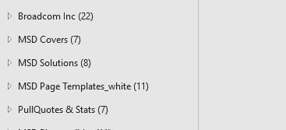
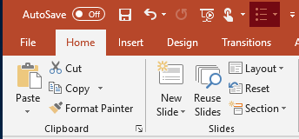
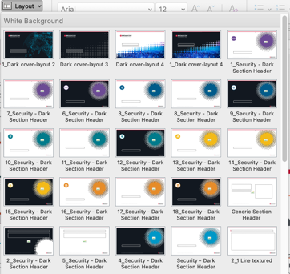
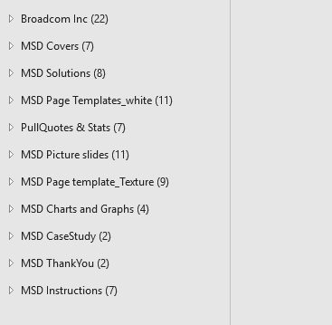
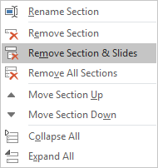
If you’d like to use specific layouts in your custom deck, move them to one section of your deck, or plan to build your deck from “scratch” using the Layout option in the top ribbon of PowerPoint.
Managing Content
Section Labels: Slide samples are grouped in labeled sections, allowing you to quickly determine which slide sets support your message. Remember to delete unnecessary sections to reduce overall file size; see step-by-step instructions below.
Creating New Layouts: If you’d like to add specific layouts to an existing deck, or plan to build your deck from “scratch,” use the Layout option in the top ribbon of PowerPoint under the Home tab.
Deleting Sections: After you’ve selected the layouts you plan to use, remember to delete the sections with slide layouts you don’t need. Use the arrow at the left of each section label to collapse the section folder. Right click on the section and select “Remove Section & Slides” to delete full sections at a time or select “Remove All Sections” to remove everything at once.

Slide 25


Inserting New Slides
Certain slides in this template are designed with responsive tables that allow the red vertical headline accent to adjust in height according to your headline length. When inserting new slides, it is necessary to copy/paste the headline table from the original slide.
For example, when using the PowerPoint “New Slide” function (under Insert or Home tabs) and selecting the cover layout below, no headline will be displayed initially.
You will need to copy/paste “Insert Headline” table from the sample slide layout in the template.

Slide 26
Typography Structure
Cover and divider headlines:
Arial Bold 44pt
Text page headlines: Arial Bold 38pt
Subtitles: Arial Bold 20pt
Body copy: Arial 16 pt
Level one bullet copy: Arial 14 pt
Level two bullet copy: Arial 12 pt
Level three bullet copy: Arial 12 pt

Slide 27
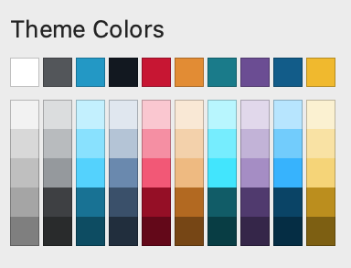
Typography Color Usage
The template comes with ‘Theme Colors’ preinstalled. Please use these preset colors as your primary color palette source. For additional information on color usage or photography color treatments, visit the Mainframe Software Creative System Guide.
Headlines:
#FFFFFF
#111820
Subheads:
#0098c7 Solution Palette Colors:
#007B8C AIOps
#6C4B94 DevOps
#F3BA16 Infrastructure
#005C8A Security
#005C8A Data Management Body Copy:
#111820
Note: Security has a darker variation of their blue solution color for limited use to highlight a key point or image.

Slide 28

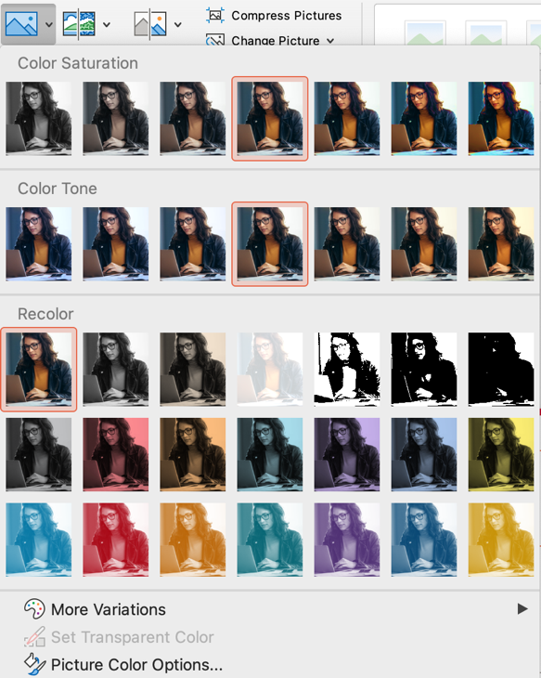

Photo Use and Correction
Insert Lifestyle Image
To colorize a photo:
Select the photo
Select Picture Format
Color drop down menu
Choose Recolor and then select the brand color you want to have the color appear to be
Insert Lifestyle Image
Note that images in this template are for position only. You should replace with approved images that support your message.

Slide 29
PowerPoint Best Practices
Font size should be no smaller than 12 points, and larger wherever possible.
Use sentence case throughout; do not use all caps for presentation titles, slide titles, content subheads, body copy, chart titles, etc.
Keep content short and succinct. Leverage speaker notes for long-form copy. Use slides to show focal points for discussion.
Remove graphic effects such as drop shadows from objects built directly in PowerPoint.
Avoid flashy transitions such as text fly-ins. These features can be distracting and rarely support the message.
Add date to a cover by selecting "Insert > Text Box", drawing the text box, then selecting "Insert > Date & Time."
Use spell check! This tool can be found under “Review > Spelling”.
Important Note About Reducing File Size: After creating your deck and removing unnecessary slides, take the time to also delete unnecessary master slides. Go to View/Slide Master and hover over each slide to find master slides that do not have associated slides in the “normal” view.

